Slide 1
MELBOURNE Housing Price
DATA SCIENCE
Anjali Chauhan
3154
2022 - 2023
Foundation of Data Science
Prof: Ankit Ganesh

Slide 2
Melbourne Housing
Melbourne, city, capital of the state of Victoria, Australia.
The central city is home to about 136,000 people and is the core of an extensive metropolitan area—the world’s most southerly with a population of more than 1,000,000.
The dataset has data of Melbourne housing price from year 2016 - 2018.
Dataset contains columns : Suburb, Address, Rooms, Type, Price, Sales_Method, Agent, Date_Sold, Distance, Postcode, No_of_Bedroom, Bathroom, Council_Area, Region, Property_Count.

Slide 3
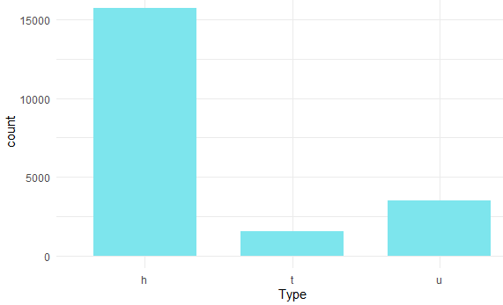
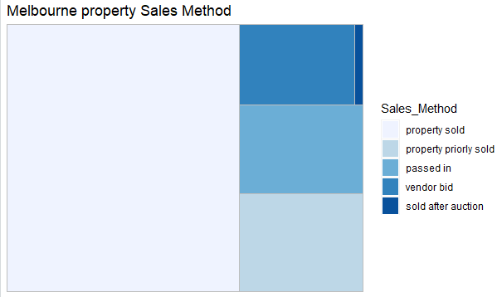
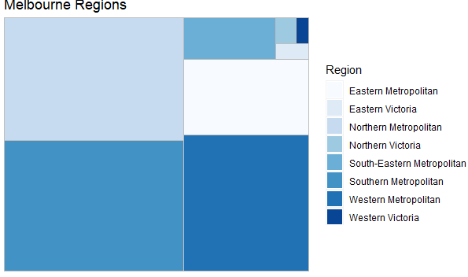
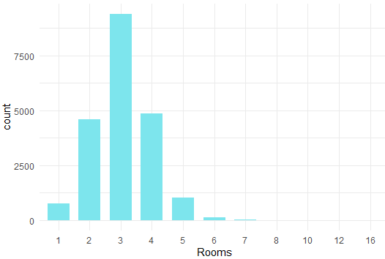

Slide 4
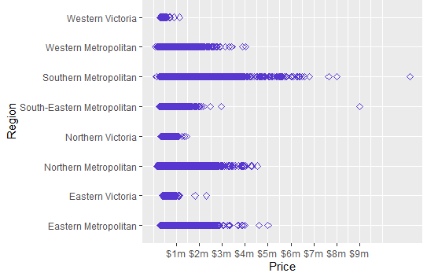
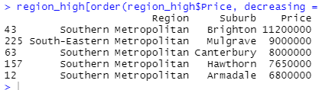
#Which region is the most expensive region?
#Which region is the most expensive region with its suburb?
Notes:
Southern metropolitan region is more expensive region in Melbourne.
To be exact Brighton Suburb in Southern region.
Secoed Northern metropolitan after Southern and western Victoria the least expensive region among all.

Slide 5
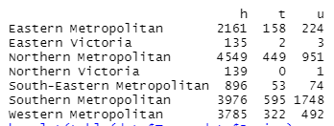
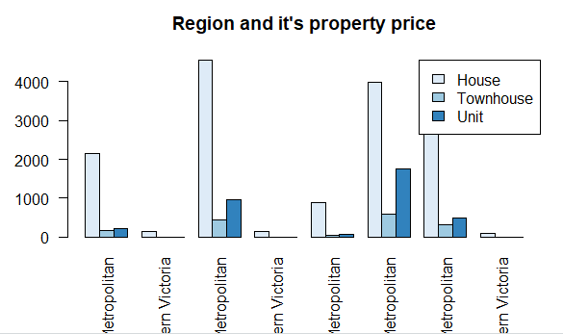
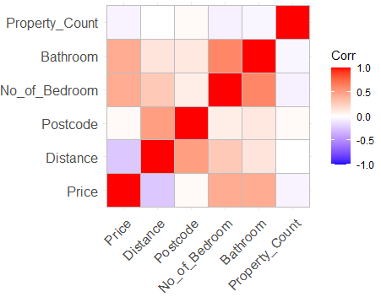
#Which region has what type of real estate?
Notes:
The graph above shows all Regions in Melbourne that has what type of property respectively.
Southern metropolitan region has most property.
Most houses are in Northern metropolitan region.
Southern Metropolitan region as more townhouses and units/Apartments.

Slide 6
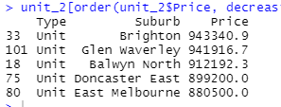
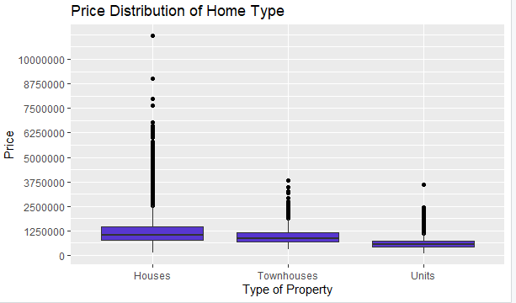
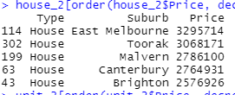
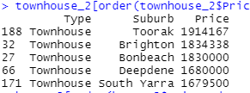
#Which Suburb is most expensive wrt to type?
#Which type of real estate are expensive?
Notes:
Houses are most expensive then townhouse and units.
Among Houses, house in Eastern Melbourne suburb are upscale.
In the group of townhouse Toorak suburb and for unit Brighton suburb are pricey.

Slide 7
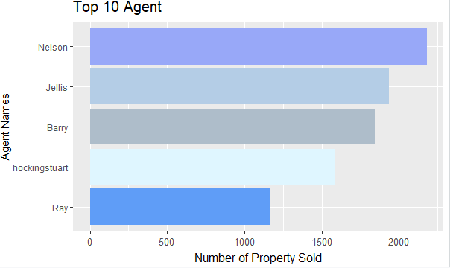
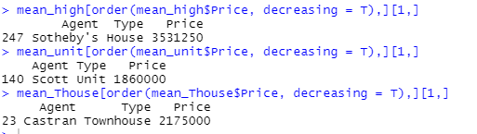
#which Agent has sold most properties?
#which Agent has sold most properties wrt to type at highest price?
Notes:
The graph shows top 10 agent that has sold most properties.
Agent Nelson selling out more than 2000 properties.
House sold in melbourne at highest price was by Sotheby’s.
Unit/Apartment sold in melbourne at highest price was by Scott.
Townhouse sold in melbourne at highest price was by Castran.

Slide 8
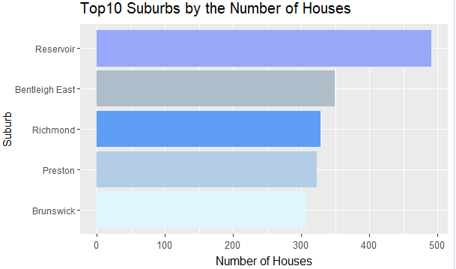
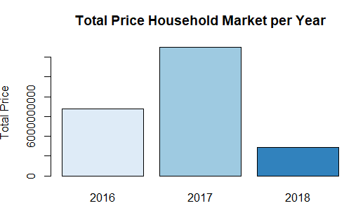
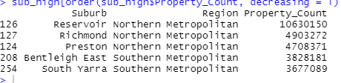
#Which suburb has most property count?
#Which year melbourne housing property price was at its peak?
Notes:
Reservoir Suburb and most property in Melbourne.
Followed by Bentleigh East, Richmond, Preston and Brunswick.

